Slide 1

Name:-PRAGYANMITA BARIK
REGISTRATION NO.2305260007
4TH SEMESTER

Slide 2
Introduction to Librarium
A Librarium is a digital solution designed to streamline the operations of a library, making it more efficient and user-friendly. It helps librarians, students, and book enthusiasts manage book records, track borrowing and returning of books, and maintain an organized catalog.
In traditional libraries, maintaining records manually is time-consuming and prone to errors. An LMS automates these processes, reducing paperwork and improving accuracy. The system typically includes features such as book search, member registration, book issuance, return management, fine calculation, and report generation.
With modern library management systems, users can easily check the availability of books, reserve them online, and even access e-books or digital resources. By integrating technology, libraries can enhance their services, making knowledge more accessible to users.
Overall, an LMS is an essential tool for educational institutions, public libraries, and private organizations, ensuring smooth and effective library operations.

Slide 3
content
1.Objective
2.Key Features
3.System Requirement
4.Tools and Technology
5.ER Diagram
6.benfits
7 library panel
8.Future Enhancements
9.Challenges and solution
10.Security features
11.Conclusion

Slide 4
Object of the PROJECT
The Librarium is designed to improve the efficiency of library operations and enhance user experience. The key objectives include:
Efficient Book Management – Maintain a digital catalog of books, making it easier to organize, search, and update book records.
Automated Borrowing & Returning – Streamline the process of issuing and returning books, reducing manual work and minimizing errors.
User Registration & Management – Keep records of library members, including students, staff, and external users, for better tracking of borrowed books.
Real-time Book Tracking – Monitor the availability and location of books within the library to prevent loss or misplacement.
Fine Calculation & Payment Management – Automatically calculate fines for late returns and provide a transparent system for fee collection.
Search & Catalog System – Enable users to search for books by title, author, subject, or category through an efficient search function.
Security & Access Control – Prevent unauthorized access to books and records by implementing login credentials for staff and members.
Reports & Analytics – Generate reports on book usage, popular titles, overdue books, and member activity to improve decision-making.

Slide 5
E-Book & Digital Resource Integration – Support access to digital materials, online journals, and e-books to expand the library’s offerings.
User-Friendly Interface – Provide an intuitive system that makes it easy for both librarians and users to navigate and manage resources.

Slide 6
Key features
Posts/Articles:A Library Management System (LMS) is a software solution that helps libraries efficiently manage book records, user data, borrowing, and returns. It automates tasks like cataloging, fine calculation, and book tracking, reducing manual effort and improving accuracy. With features like online book searches, digital resource access, and automated reports, an LMS enhances user experience and streamlines library administration. It is an essential tool for schools, colleges, and public libraries to ensure smooth

Slide 7
SYSTEM REQUIREMENTS
Hardware Requirements
Display: 1920x1080 resolution Monitor.
Processor: Intel Core i5 or higher.
Network: Internet connectivity or Wi-Fi.
Storage: At least 256GB SSD.
RAM: 8GB or higher.

Slide 8
Software Requirements
Visual Studio Code.
Git
My SQL
XAMPP

Slide 9
TOOLS AND TECHNOLOGY
Graphical User Interface will be the preferred front-end interface to information display, since easy to use even for inexperienced users, it is attractive, provide shortcuts, and allows room for multitasking.
HTML
Hyper Text Mark-up Language is used for developing front-end Graphical user interface. It is standard language used for web pages.
CSS
Cascading style sheets are a style sheet language used to show a document or content written in mark-up language.
SPRING BOOT
Spring Boot is a Java framework that makes it easier to create and run Java applications. It simplifies the configuration and setup process, allowing developers to focus more on writing code for their applications.

Slide 10
.
JAVA
Java is a class-based, object-oriented programming language that is designed to have as few implementation dependencies as possible. It is intended to let application developers Write Once and Run Anywhere (WORA), meaning that compiled Java code can run on all platforms that support Java without the need for recompilation.
MYSQL
For database MYSQL is used. This technology will ensure that the software is scalable, reliable, and secure.

Slide 11
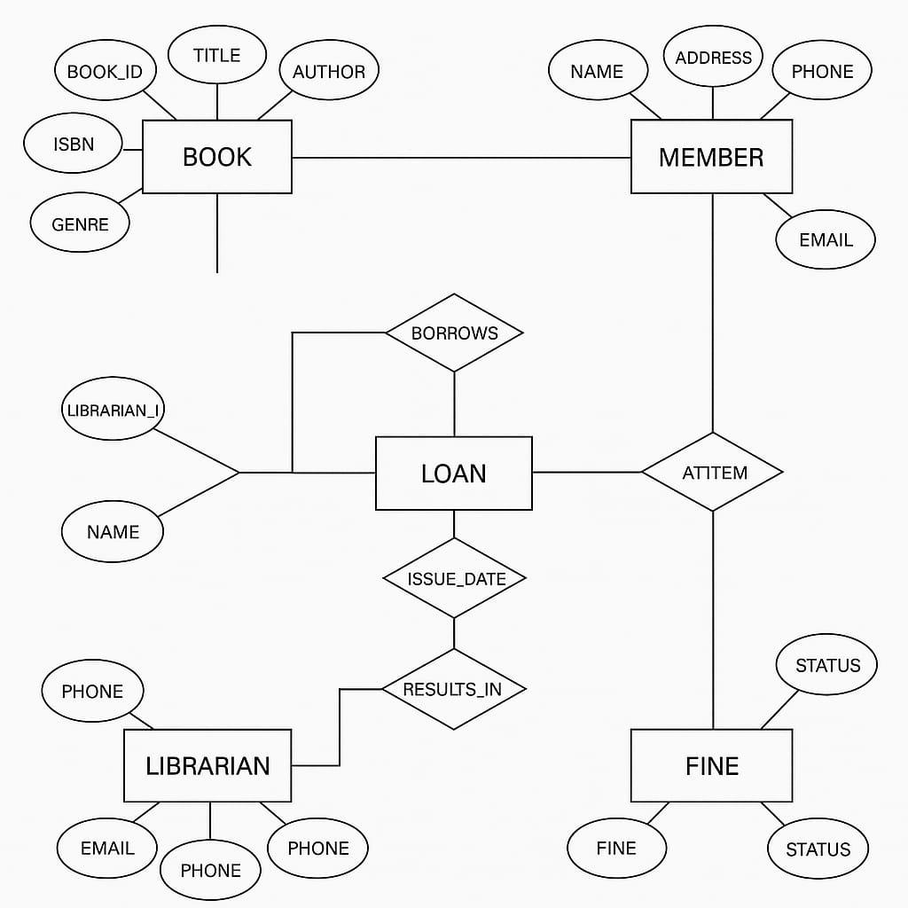
ER Diagram

Slide 12
Benefits
A Library Management System (LMS) improves efficiency by automating book cataloging, borrowing, and returns, reducing manual workload. It enhances accessibility with online book searches and reservations, making it easier for users to find resources. The system also ensures accuracy in fine calculations, book tracking, and user management, preventing errors. Additionally, LMS provides insightful reports and analytics, helping libraries optimize operations and improve service quality.

Slide 13

LIBRARY PANEL

Slide 14
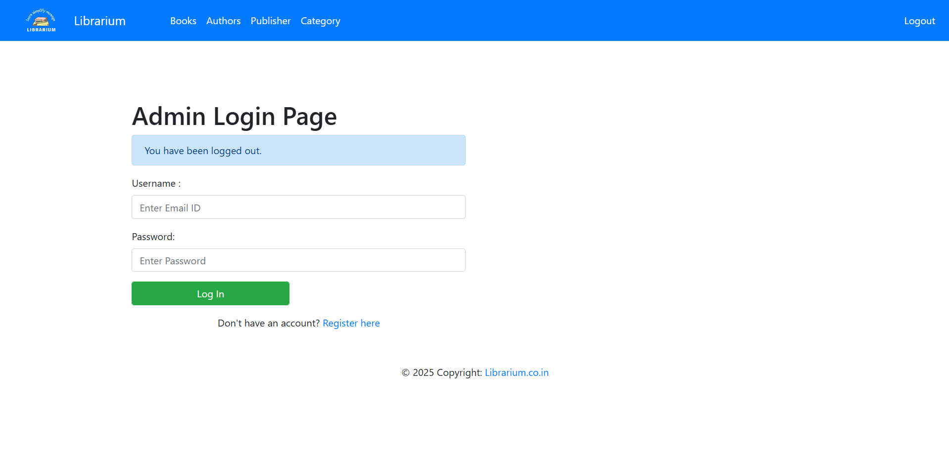

Slide 15
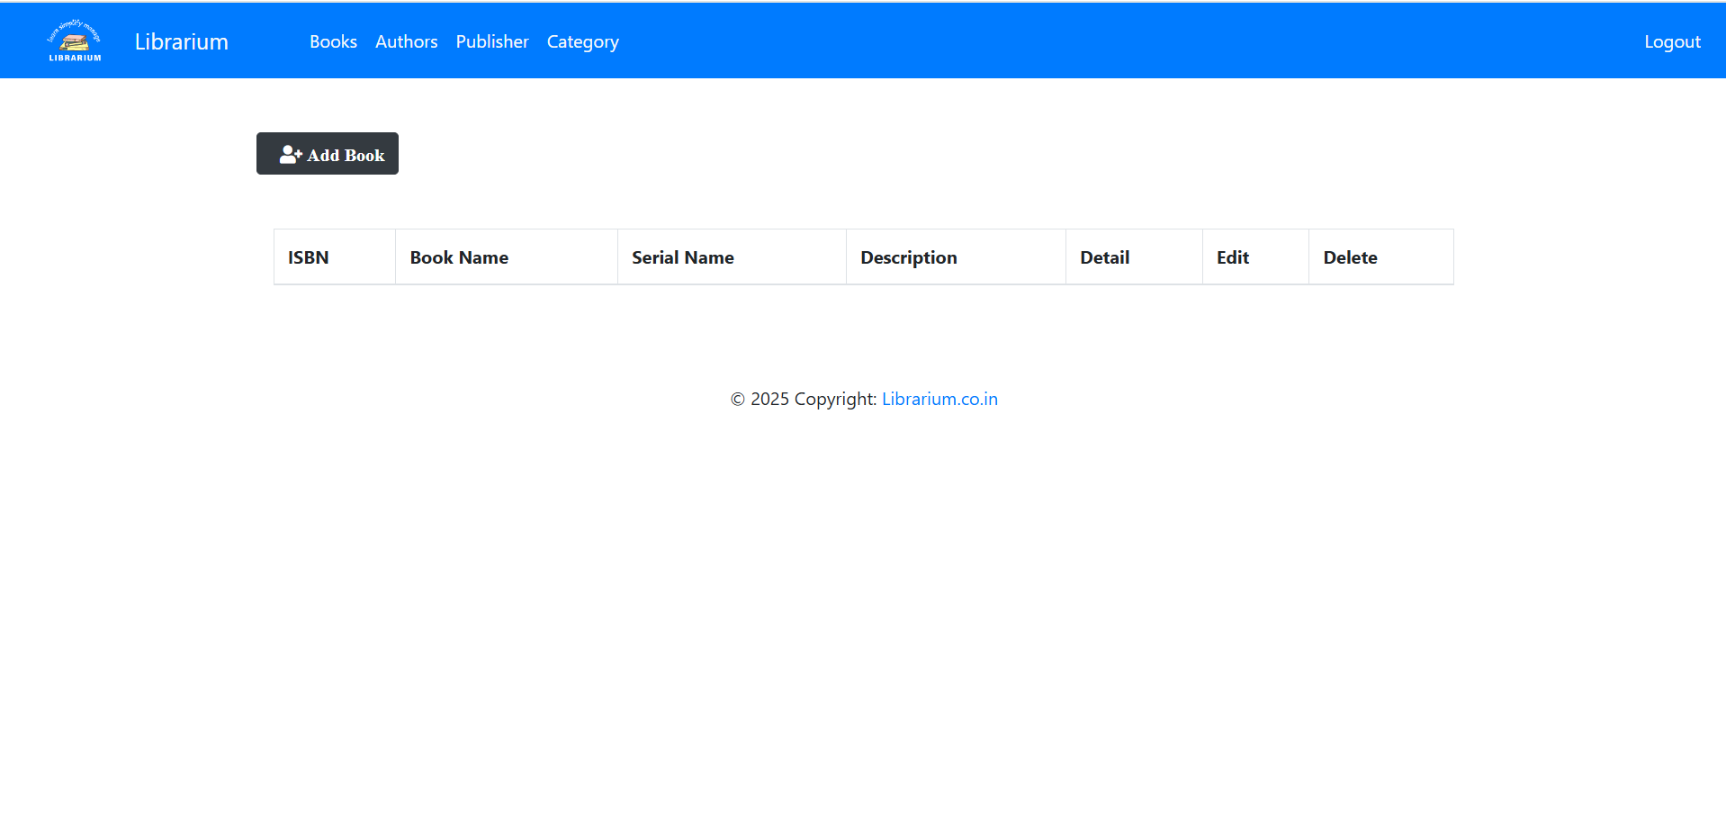

Slide 16
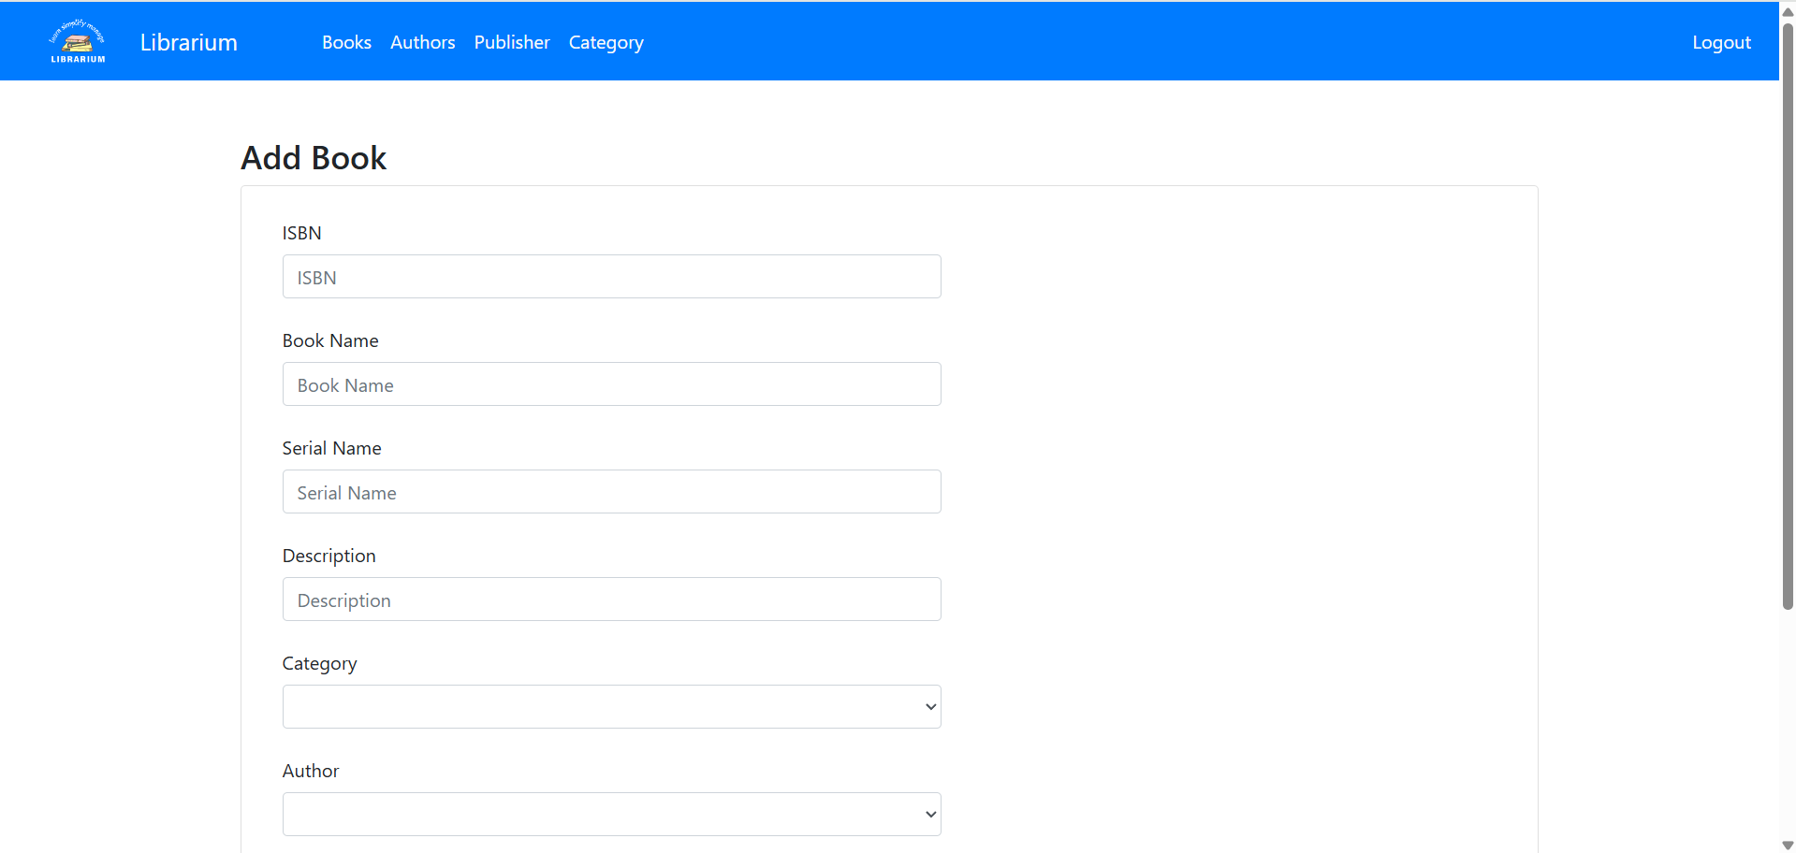

Slide 17
Security Features
Authentication & Access Control
User Authentication: Require strong passwords, two-factor authentication (2FA), or biometric verification.
Role-Based Access Control (RBAC): Define roles such as admin, librarian, and student/member, limiting access based on user roles.
Data Protection & Privacy
Encryption: Encrypt sensitive data (e.g., user credentials, payment information) using AES-256 for storage and SSL/TLS for data transmission.
Data Masking: Hide personal data for unauthorized users to prevent exposure.
Secure Transactions & Logging
Audit Logs: Keep track of user activities (e.g., book checkouts, login attempts) for security monitoring.
Backup & Disaster Recovery: Store regular encrypted backups to recover from cyberattacks or system failures.

Slide 18
Future Enhancements of Library
Management System
Future Enhancements of Library Management System
Subtitle: Improving Efficiency, Accessibility, and User Experience .

Slide 19
Introduction
Overview of the current library management system
Importance of continuous improvements.
Goals of future enhancements

Slide 20
Cloud-Based System
Remote access to library resources
Cloud storage for digital books and records
Data backup and security improvements

Slide 21
Mobile App Development
Features: Book search, reservations, overdue notifications
Barcode scanning for easy check-in/out
Personalized user dashboards

Slide 22
Conclusion
A Library Management System (LMS) is an essential tool for efficiently managing library resources, automating administrative tasks, and enhancing the user experience. By integrating security features such as authentication, data encryption, access control, and audit logs, an LMS ensures the protection of sensitive information and prevents unauthorized access.
Additionally, modern LMS solutions leverage cloud storage, AI-based monitoring, and RFID technology to streamline operations while maintaining high security standards. Regular system updates and compliance with data protection regulations further enhance the reliability and trustworthiness of the system.
Ultimately, a well-designed Library Management System improves accessibility, efficiency, and security, making it an indispensable asset for educational institutions, public libraries, and organizations.

Slide 23


